Slide 1

Cat’s Company Vulnerabilities
Deep Scan and Solutions to Keep Your Systems Safe

Slide 2
Table of Contents
3.Purpose of the presentation
4.Definitions: What is CVE and What is CVSS
5.Scope of the vulnerability scan and methodology
6.Overview of the scan
7-9. Ubuntu Scan & Recommendations
10-12. Windows Worstation1 Scan & Recommendations
13-15. Winserver Scan & Recommendations
16. Executive Summary
17. References

Slide 3
Purpose of the presentation
Welcome to our presentation on "Enhancing Cybersecurity for Cat's Company." In this session, CyberMax will share the findings of our comprehensive cybersecurity audit, highlighting potential vulnerabilities and providing actionable recommendations to strengthen Cat's Company's digital defenses.

Slide 4
Important Definitions
CVE: Common Vulnerabilities and Exposures (CVE) is a standardize framework to identify software vulnerabilities.
- Each Vulnerability gets an ID starting with “CVE followed by a year and number”
- Enables an efficient way to track vulnerabilities
https://www.cvedetails.com/
CVSS: Common Vulnerability Scoring System assesses vulnerability from severity from 0-10
- Considers the impact of an attack, it’s exploitability and other factors to determine the severity of a potential vulnerability or threat
-Provides a standard language for risk assessment
https://www.balbix.com/insights/understanding-cvss-scores/
Mitre Att&ck:
Framework that provides a detailed knowledge of cyber adversaries tactics. The Mitre Att&ck is used for threat hunting and incident response among other things. https://attack.mitre.org/#

Slide 5
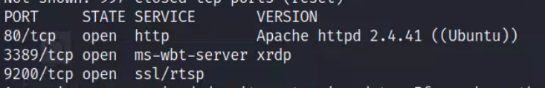
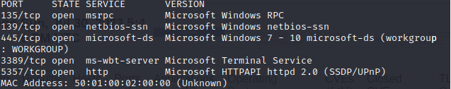
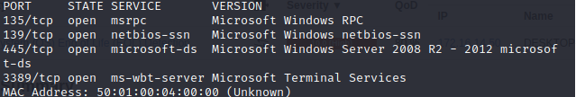
Scope of the Vulnerability Scan & Methodology
A preliminary Nmap using a Kali machine has been done on 3 devices that are part of the scope of our research namely a Linux Ubuntu (172.16.14.52), a Windows Server (172.16.14.53) and Windows Workstation 1 (172.16.14.50). The objective of this Nmap scan is to observe the pattern a less experience technical “hacker” may adopt. It also highlights the preliminary information a more experiences “hacker” could see before potentially attacking Cat’s Company. Using Nmap has a baseline, CyberMax will have a more in-depth search using OpenVas (GreenBone) to identify the vulnerabilities and provide solutions for each of the identified ones.
Linux Ubuntu: 172.16.14.52 Windows WorkStation 1: 172.16.14.50
Windows Server: 172.16.14.53
Windows Server: 172.16.14.53

Slide 6
Overview of the OpenVAS Scan
The scan was performed using OpenVAS. The reason why CyberMax used OpenVAS is because of it is widely recognized, has a comprehensive scanning and report system and incorporates the CVE and CVSS in its analyses

Slide 7
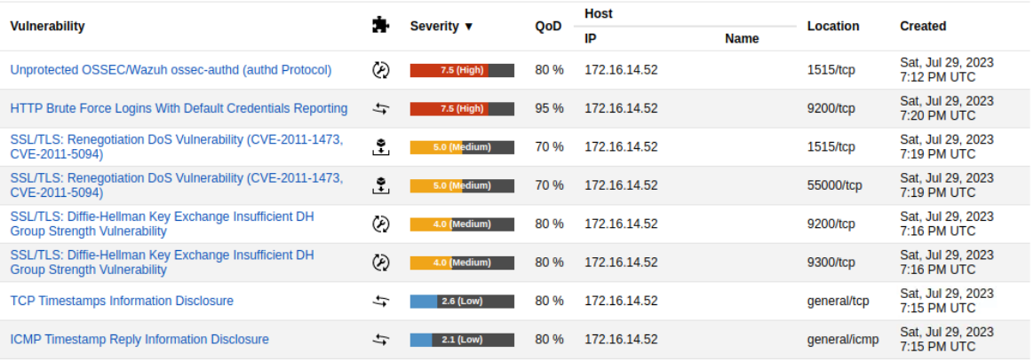
OpenVAS Linux Ubuntu Vulnerabilities
The scan on Ubuntu uncovered a vulnerability on port 9200/tcp. The vulnerability is a critical one and is the HTTP Brute Force Logins with Default Credentials Reporting on port 1515/tcp. This vulnerability makes it easier for an attacker to penetrate the network by using any app/device to try as many passwords as possible in a short period of time (Brute force method). The scan uncovered that the Ubuntu device uses the default password. Making it even more vulnerable. Changing the password for a 12 characters password with numbers and special characters will greatly mitigate the vulnerability.

Slide 8
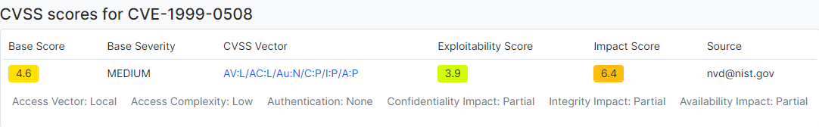
Linux Ubuntu Vulnerabilities CVE
The severity of a brute force attack on the network is quite high and the complexity of such an attack is low. A source mentions that the potential “hacker” must have local access to perform a brute force and another one alleges the opposite (remote access). CyberMax will consider the threat has possible through remote access.
https://www.cvedetails.com/cve/CVE-1999-0508/?q=CVE-1999-0508
The switch is provided by BayStack firmware. The default password is “NetlCs”. Gaining access to this password that is likely on an online password library will give access to a “hacker” and potentially grant them administrative authority Cat’s company network. This means they can modify configurations, manipulate network traffic, intercept sensitive data, or even disrupt the entire network's operations. Thus enhancing the scope of the vulnerability on Cat’s company. Based on our assessment, this threat’s impact on Cat’s Company should be higher than 6.4 has shown above and should be treated as a 9/10 and the exploitability, provided that the passwords on the port remains has the default one, should be considered a 5/5. The base severity should be way higher as well in the context of Cat’s Company. It should be above 8. https://exchange.xforce.ibmcloud.com/vulnerabilities/1933

Slide 9
Linux Ubuntu Recommendations
Change the default password immediately
Put in place a password with 12 or more characters that includes special characters and numbers
Enforce the principle of “least privilege” making sure that only authorized members have access to administrative privilege
Require additional information to access the device commonly knows has Multi-Factor Authentication (MFA)
Have regular updates
Have intrusion detection and monitoring systems in place
https://sucuri.net/guides/what-is-brute-force-attack/

Slide 10
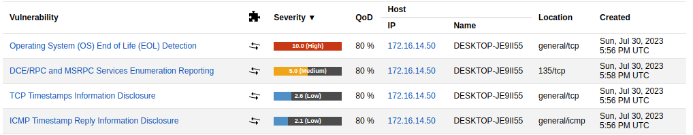
OpenVAS & CVE Windows Workstation1
The scan on the Windows Workstation uncovered a critical vulnerability on the general/tcp port. The critical vulnerability is the Operating System (OS) End of life (EOL) Detection. This vulnerability indicated that the software vendor (windows in that instance) has stop providing updates, patches or any other support for that version of the software. An attacker could potentially exploit known or even newly discovered vulnerabilities in an EOL and gains unauthorized access or compromise the system’s security. The windows workstation 1 has the “DCE/RPC and MSRPC Services Enumeration Reporting” vulnerability on port 135/tcp. The latter vulnerability allows an attacker to gain more knowledge about the remote host. Although labeled has a lower risk that the previous one, this vulnerability allows the attacker to gather a great deal of information through reconnaissance and the scope of the potential damage could spread throughout Cat’s company.
http://www.securityspace.com/smysecure/catid.html?id=1.3.6.1.4.1.25623.1.0.103674
http://www.securityspace.com/smysecure/catid.html?id=1.3.6.1.4.1.25623.1.0.10736

Slide 11
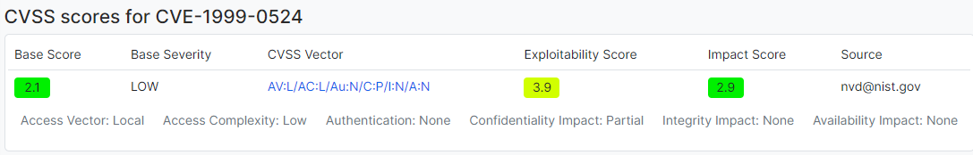
Windows Workstation Vulnerability CVE
CyberMax also analyzed a lower risk vulnerability the TCP Time Timestamps Information Disclosure the CVE id is CVE-1999-0524. The purpose of showcasing a lower severity vulnerability is to show the stakeholders and example of vulnerabilities that we will be ignoring. This vulnerability allows a potential attacker to determine Cat’s Company clock state and time zone. This is vulnerability is easily exploitable, but in terms of impact scope it is not relevant to the company. This risk can be ignored, and more resources can be allocated to more pressing severe vulnerabilities.
https://www.cvedetails.com/cve/CVE-1999-0524/
https://exchange.xforce.ibmcloud.com/vulnerabilities/322

Slide 12
Windows Workstation1 Recommendations
Operating System (OS) End of life (EOL) Detection
Upgrade the Operating System on the remote host to a version which is still supported and receiving security updates by the vendor http://www.securityspace.com/smysecure/catid.html?id=1.3.6..4.1.25623.1.0.103674
DCE/RPC and MSRPC Services Enumeration Reporting
Implement encryption for communication between systems and services. Using secure encryption protocols like TLS/SSL protects sensitive data transmitted over the network. This would greatly reduce the vulnerability being exploited
TCP Time Timestamps Information Disclosure the CVE id is CVE-1999-0524
CyberMax recommends ignoring this vulnerability for the time being. Resources should be allocated to more pressing vulnerabilities.

Slide 13
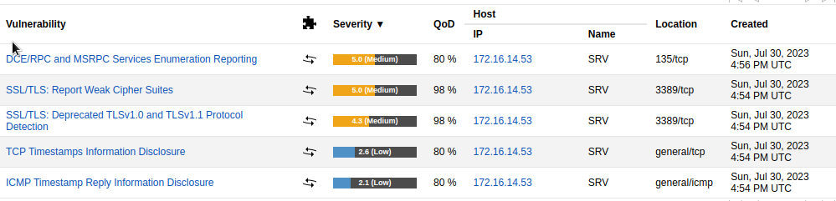
OpenVAS Winserver Vulnerabilities
The scan on the Windows Server (Winserver1) uncovered a “DCE/RPC and MSRPC Services Enumeration Reporting on port 135/tcp (we will not go over this one again)” the same vulnerability on port 135/tcp mentioned in the Windows Workstation 1. However, the Winserver also has a “SSL/TLS : Report Weak Cipher Suites” vulnerability on port 3389/tcp. Cipher Suites are meant to provide secure communication over a network ensuring confidentiality and integrity of data transmission. In other words, it is a two ways communication between the clients and our web browser, The communication is done through an exchange of “keys”. A Weak Cipher Suite may potentially allow someone to “brute force” the encryption key password (as mentioned in slide #7), or someone may perform a Cypher text attack and recover sensitive information by deduction without ever having to decrypt the data (man in the middle attack).
http://www.securityspace.com/smysecure/catid.html?id=1.3.6.1.4.1.25623.1.0.103440

Slide 14
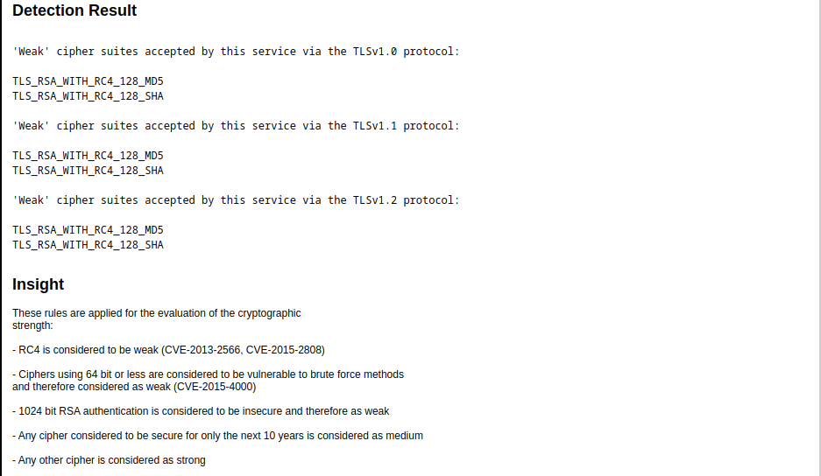
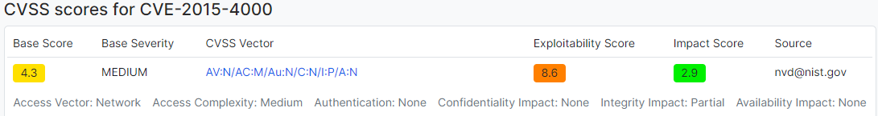
Winserver CVE & Cipher SUites
As mentioned in the previous slide Cipher Suites are meant to provide secure communication over a network ensuring confidentiality and integrity of data transmission. In other words, it is a two ways communication between the clients and our web browser. Our web browser is identified as TLS_RSA and the client starts with RC4. However, RC4 are weak and vulnerable cipher suites (see the detection results).
https://www.cvedetails.com/cve/CVE-2015-4000/?q=CVE-2015-4000
http://www.securityspace.com/smysecure/catid.html?id=1.3.6.1.4.1.25623.1.0.103440

Slide 15
Winserver Recommendation
A good solution would be to prevent any port in your system, but especially port 3389/tcp to accept services/communications from any of the Cipher Suites mentioned in the figure below (same figure as the previous slide).

Slide 16
Executive Summary
CyberMax conducted a comprehensive cybersecurity audit for Cat's Company, identifying critical vulnerabilities. Using industry best practices, we analyzed CVE and CVSS for severity assessment.
Nmap and OpenVAS scans highlighted potential risks in Ubuntu, Windows Server, and Windows Workstation 1. Mitigation strategies include strong passwords, least privilege, MFA, regular updates, and intrusion detection.
Addressing End of Life (EOL) detection, DCE/RPC, and weak Cipher Suites on the Windows Server is crucial. Implementing secure communication protocols is recommended.
Adhering to these measures will bolster Cat's Company's cybersecurity, protect assets, and ensure proactive defense against cyber threats. CyberMax is here to assist in implementing these measures for ongoing success.

Slide 17
References
https://www.cvedetails.com/
https://www.balbix.com/insights/understanding-cvss-scores/
https://attack.mitre.org/#
https://www.cvedetails.com/cve/CVE-1999-0508/?q=CVE-1999-0508
https://exchange.xforce.ibmcloud.com/vulnerabilities/1933
https://sucuri.net/guides/what-is-brute-force-attack/
http://www.securityspace.com/smysecure/catid.html?id=1.3.6.1.4.1.25623.1.0.103674
http://www.securityspace.com/smysecure/catid.html?id=1.3.6.1.4.1.25623.1.0.10736
https://www.cvedetails.com/cve/CVE-1999-0524/
https://exchange.xforce.ibmcloud.com/vulnerabilities/322
http://www.securityspace.com/smysecure/catid.html?id=1.3.6..4.1.25623.1.0.103674
http://www.securityspace.com/smysecure/catid.html?id=1.3.6.1.4.1.25623.1.0.103440
https://www.cvedetails.com/cve/CVE-2015-4000/?q=CVE-2015-4000
http://www.securityspace.com/smysecure/catid.html?id=1.3.6.1.4.1.25623.1.0.103440

